Slide 1
Creating an Epidemic Model
Steven Blythe

Slide 2
TABLE OF CONTENTS
1.
4.
2.
5.
3.
6.
Introduction
Predator-Prey Systems
Model Building
SIR Modeling
Logistic Population Model
Visualizing our Pandemic

Slide 3
What Is Differential Equation?
We use differential equations to relate one or more functions and its derivatives.
We can create a model to represent some tangible property of a model and the model’s rate of change.
The goal of our models are not to create a perfect representation of an event from the real world. These models are a mere representation of an event with the goal to help understand an aspect of the event.
Build models with the goal to tweak and revamp our initial model.
Notes:
.
.
Model for amount of crop yield in a given year based on crop data. | Blueberries tend to bloom over the summer so we should expect a higher yield over the summer. Consider real-world factors such as droughts, demand fluctuation, and ongoing diseases may lower crop yield in a given year.
When we build models, we should look to compare our model with data from the real world. If our model accurately describes what we are representing, then we have created a tool to assist us in predicting a system. Otherwise, if our model is wrong, we should study and pay close attention to our model to improve our knowledge for our assumption.

Slide 4
Model Building
How might we go about modeling population growth?
Let us first consider an example with concrete numbers:
Population: 100
Time Interval: 1 Year
What does a 20% increase look like?
1st year: 100 * 0.20 + 100 = 120
2nd year: 120 * 0.20 + 120 = 144
Notes:
If we want to create a model to predict population growth, how should we go about it?
Here, let us look an example with concrete numbers
Here, we can calculate our population one step at a time.

Slide 5
Model Building
How might we go about modeling population growth?
Let us first consider an example with concrete numbers:
Population: 100
Time Interval: 1 Year
What does a 20% increase look like?
1st year: 100 * 0.20 = 20
2nd year: 120 * 0.20 = 24
Notes:
Let us look closer at how much our population changes every year.
What if we want to generalize our growth rate? Here we can replace 20% with k.

Slide 6
Model Building
How might we go about modeling population growth?
Let us first consider an example with concrete numbers:
Population: 100
Time Interval: 1 Year
What does a k increase look like?
1st year change: 100 * k
Notes:
What if we want to generalize our growth rate? Here we can replace 20% with k.
Now let us generalize our population

Slide 7
Model Building
How might we go about modeling population growth?
Let us first consider an example with concrete numbers:
Population: P
Time Interval: 1 Year
What does a k increase look like?
1st year change: P * k
Notes:
This term here is telling us how much our population changes at a certain time. Here we create a differential equation.

Slide 8
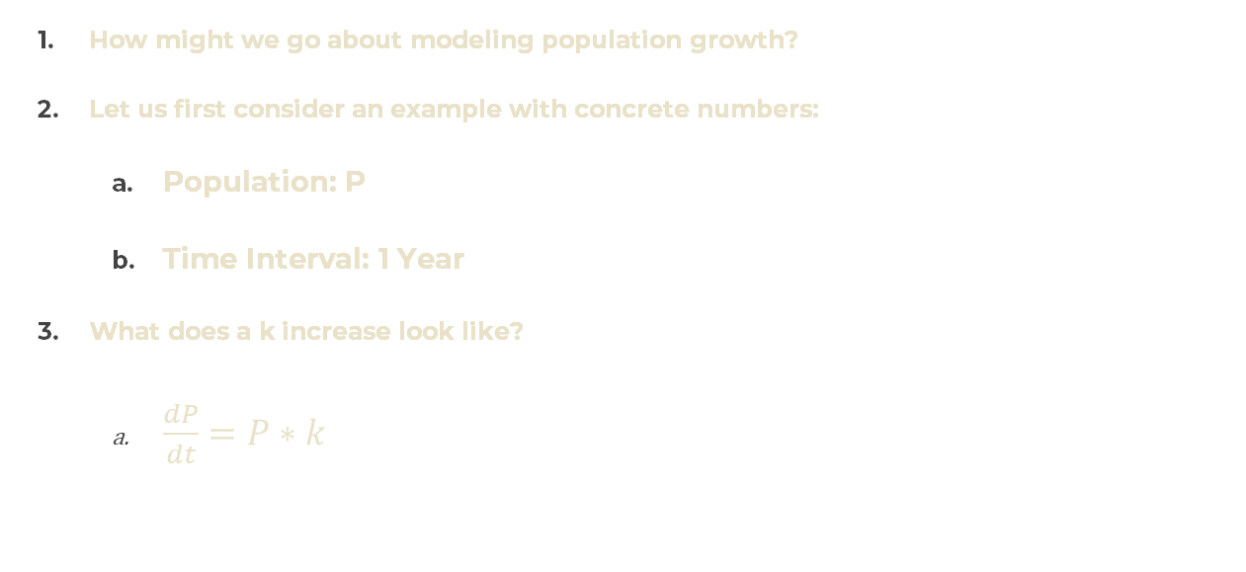
Model Building
How might we go about modeling population growth?
Let us first consider an example with concrete numbers:
Population: P
Time Interval: 1 Year
What does a k increase look like?
$\frac{dP}{dt}=P∗k$
Notes:
This term here is telling us how much our population changes at a certain time. Here we create a differential equation.

Slide 9
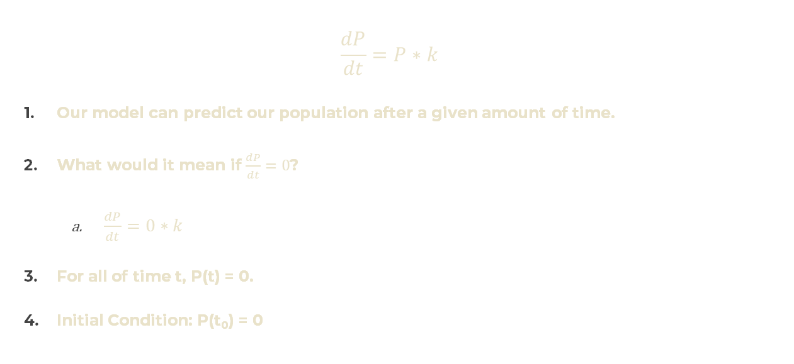
Finding Meaning In Our Models
$$\frac{dP}{dt}=P∗k$$
Our model can predict our population after a given amount of time.
What would it mean if $\frac{dP}{dt}=0$?
$\frac{dP}{dt}=0∗k$
For all of time t, P(t) = 0.
Initial Condition: P(t₀) = 0
Notes:
Our model always assumes our population will grow at a rate k.
Since our rate of growth is positive, that means our population P must have began at 0.
We can predict at t = 1000, our population is 0. Since the growth rate is a positive constant, we can expect the year before that to be 0. We can keep going back until we reach t = 0, which is our initial condition.
Can we expect our differential equation to become negative at some point?

Slide 10
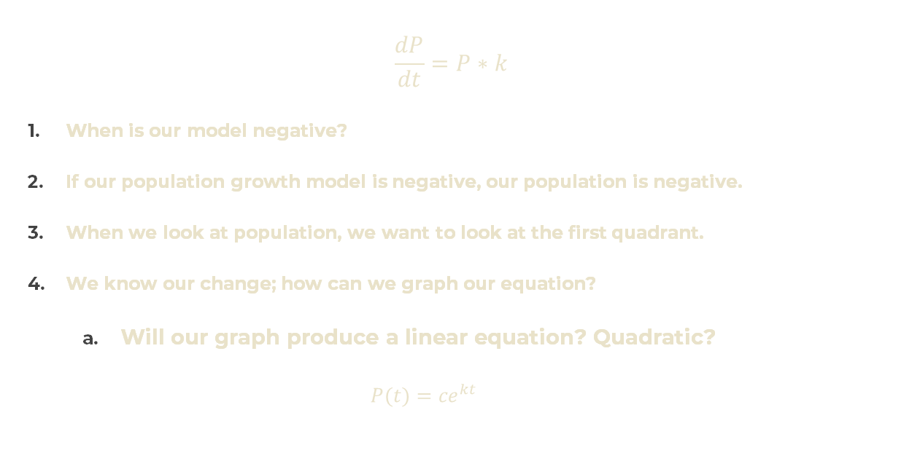
Finding Meaning In Our Models
$$\frac{dP}{dt}=P∗k$$
When is our model negative?
If our population growth model is negative, our population is negative.
When we look at population, we want to look at the first quadrant.
We know our change; how can we graph our equation?
Will our graph produce a linear equation? Quadratic?
$$P(t)={ce}^{kt}$$
Notes:
Can we expect our differential equation to be negative at some point?
For our population growth model, k isa constant positive. The only way for our differential equation to be negative is if our population is negative.
What does it mean to have a negative population? Can I say the empty classroom next door has a negative population?
If we graph kP, we only have a linear graph. Should our growth, which is proportional to our current population, produce a linear graph? If our growth is 20% and our initial population is 100, we may expect an increase of roughly 20 people in one time step. If we move another time step, should we expect the same increase of 20 or an increase of 24?
How can we get our equation? We can’t integrate in terms of P because we our equation is measuring the change of P as we modify time. Let’s jump forward and look at our equation:
I won’t bog you down too much with the details.

Slide 11
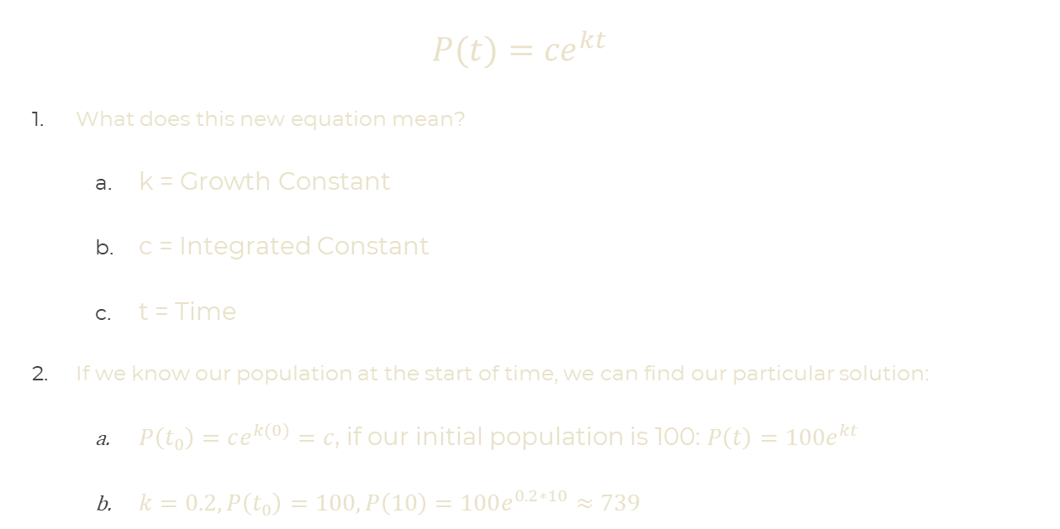
Finding Meaning In Our Models
$$P(t)={ce}^{kt}$$
What does this new equation mean?
k = Growth Constant
c = Integrated Constant
t = Time
If we know our population at the start of time, we can find our particular solution:
$P\left(t_{0}\right)=ce^{k(0)}=c$, if our initial population is 100: $P\left(t\right)=100e^{kt}$
$k=0.2, P\left(t_{0}\right)=100, P\left(10\right)=100e^{0.2∗10}≈739$
Notes:
Next: Graphing

Slide 12

GRAPH

Slide 13
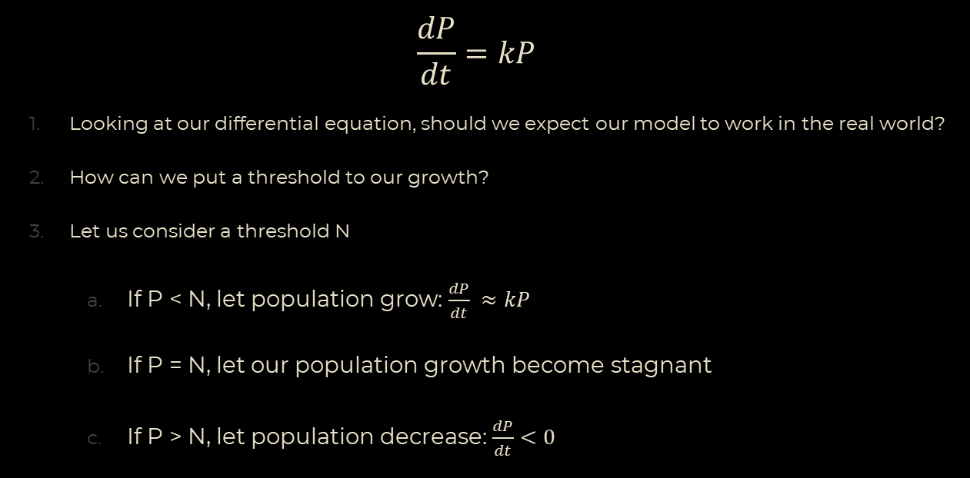
Logistic Population Model
$$\frac{dP}{dt}=kP$$
Looking at our differential equation, should we expect our model to work in the real world?
How can we put a threshold to our growth?
Let us consider a threshold N
If P < N, let population grow: $\frac{dP}{dt} ≈kP$
If P = N, let our population growth become stagnant
If P > N, let population decrease: $\frac{dP}{dt}<0$
Notes:
Model does not always work in the real world.
Bacteria vs Rabbits

Slide 14
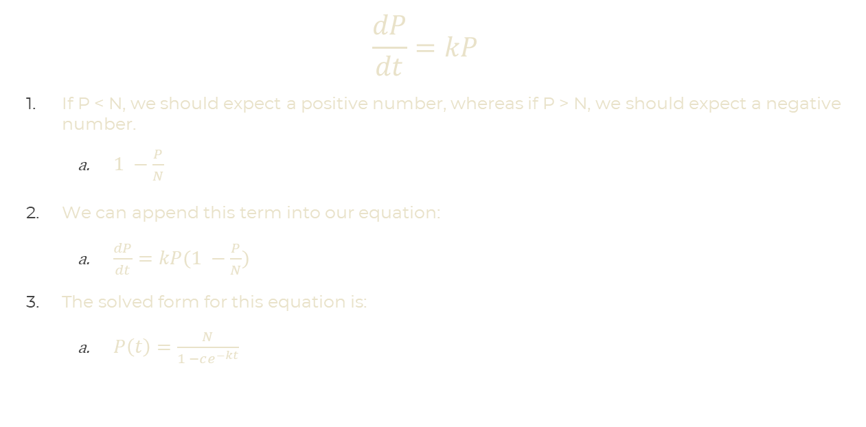
Logistic Population Model
$$\frac{dP}{dt}=kP$$
If P < N, we should expect a positive number, whereas if P > N, we should expect a negative number.
$1 −\frac{P}{N}$
We can append this term into our equation:
$\frac{dP}{dt}=kP(1 −\frac{P}{N})$
The solved form for this equation is:
$P\left(t\right)=\frac{N}{1 −ce^{−kt}}$
Notes:
Model does not always work in the real world.
Bacteria vs Rabbits
k: Rate of growth
T: time
N: Carrying Capacity
C: Constant from our integration.
P(0) = Initial Condition

Slide 15
GRAPH

Slide 16
Predator-Prey Systems
How can we modify our model to include other variable factors?
We created a logistic population model which considers limited resources in a given area.
How can we model a rabbit population with a predator, such as a fox, in the area?
We can make the following assumptions
Rabbits will have unbounded growth.
Rabbits lose a portion of its population proportional to Fox-Rabbit interactions
Foxes benefit from Fox-Rabbit interactions
Foxes cannot sustain themselves without rabbits.
Notes:
Heat Transfer, population

Slide 17
Predator-Prey Systems
Our assumptions:
Rabbits will have unbounded growth.
Rabbits lose a portion of its population proportional to Fox-Rabbit interactions
Foxes benefit from Fox-Rabbit interactions
Foxes cannot sustain themselves without rabbits.
Our variables:
R: Rabbits
α: Rabbit Growth Constant
F: Foxes
γ: Foxes Decay Constant
β: Death Rate for Fox-Rabbit Interactions
δ: Beneficial-rate for Fox-Rabbit Interactions.
Notes:
Heat Transfer, population

Slide 18
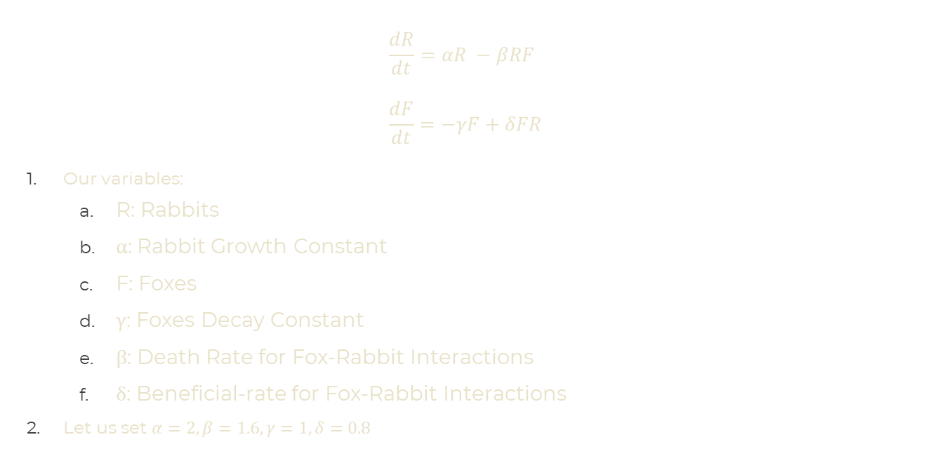
Predator-Prey Systems
$$\frac{dR}{dt}=αR −βRF \\ \frac{dF}{dt}=−γF+δFR$$
Our variables:
R: Rabbits
α: Rabbit Growth Constant
F: Foxes
γ: Foxes Decay Constant
β: Death Rate for Fox-Rabbit Interactions
δ: Beneficial-rate for Fox-Rabbit Interactions
Let us set $α=2, β=1.6, γ=1, δ=0.8$
Notes:
Heat Transfer, population

Slide 19
GRAPH

Slide 20
GRAPH
Notes:
Peaks

Slide 21
SIR Modeling
Using what we know that helped us create a predator-prey model, how can we create a model to model an epidemic?
Stages on an infection for the common cold:
A susceptible individual catches the common cold.
The newly infected individual has the infection for a few days.
The infected individual recovers from the infection.
Three stages in the infection: Susceptible, Infected, Recovered.
Notes:
Model does not always work in the real world.
Bacteria vs Rabbits

Slide 22
SIR Modeling
Our variables for the infection:
s(t) = S: Number of susceptible individuals
i(t) = I: Number of infected individuals
r(t) = R: Number of recovered individuals
How might we model our pandemic? Let us make the following assumptions:
We introduce no new population into our community.
Our susceptible population decreases at a rate proportional to the interaction between susceptible and infected individuals.
Our infected population increases by the same rate the susceptible population decreases.
The Infected population decreases by a recovery rate.
The recovered population increases by the same recovery rate.

Slide 23
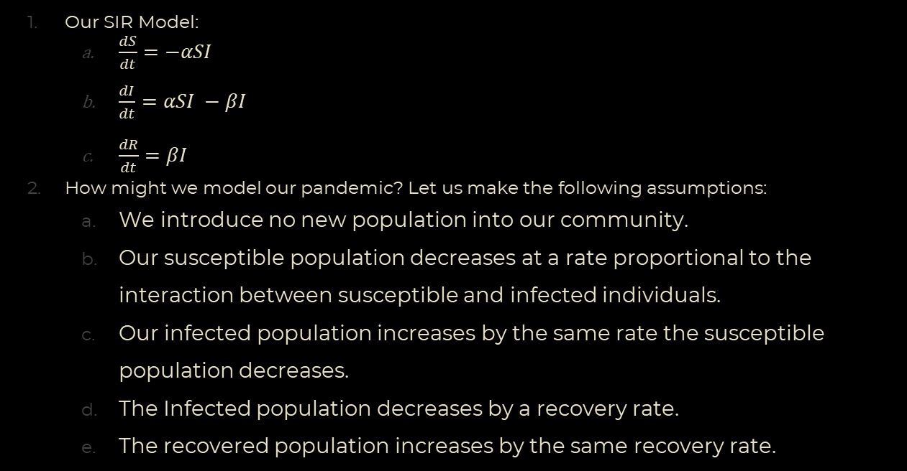
SIR Modeling
Our SIR Model:
$\frac{dS}{dt}=−αSI$
$\frac{dI}{dt}=αSI −βI$
$\frac{dR}{dt}=βI$
How might we model our pandemic? Let us make the following assumptions:
We introduce no new population into our community.
Our susceptible population decreases at a rate proportional to the interaction between susceptible and infected individuals.
Our infected population increases by the same rate the susceptible population decreases.
The Infected population decreases by a recovery rate.
The recovered population increases by the same recovery rate.

Slide 24
SIR Modeling
Consider our population N.
In our assumptions, our population does not gain or lose individuals.
Our variables for the infection:
s(t)/N = S(t): Number of susceptible individuals
i(t)/N = I(t): Number of infected individuals
r(t)/N = R(t): Number of recovered individuals
Here, S(t), I(t), and R(t) are all a fraction of our population. If we add them all together, we should find: S(t) + I(t) + R(t) = 1.
Notes:
N can be the population of a classroom or the population of a state.
Contrast with Predator-Prey model

Slide 25
Visualizing our Pandemic
Notes:
Consider how fast an infection can spread starting from one individual.

Slide 26
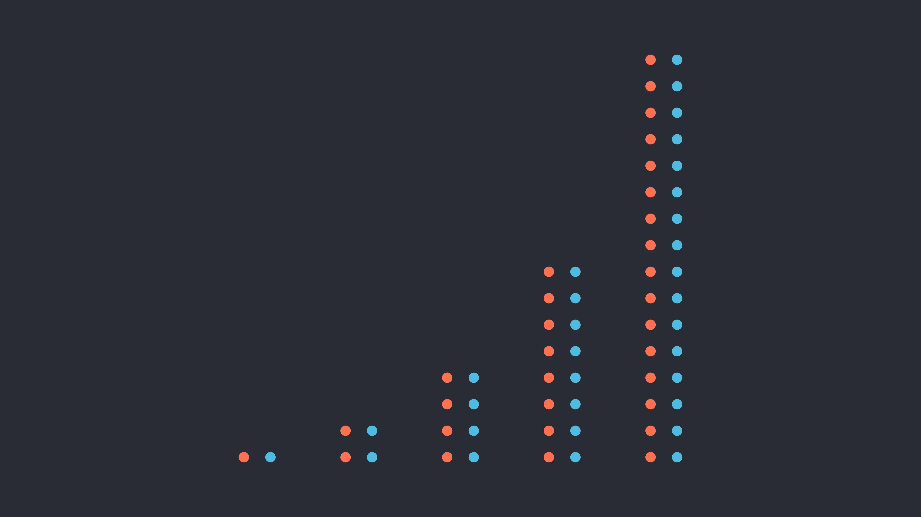
MODEL
Notes:
1-1, 2-2, 4-4, 8-8, 16-16
Looking at our model, we can see our number of infected individuals double after every time interval. If the time step is one day, that means we will have a population of 16 infected individuals after 4 days. How does this look like?

Slide 27
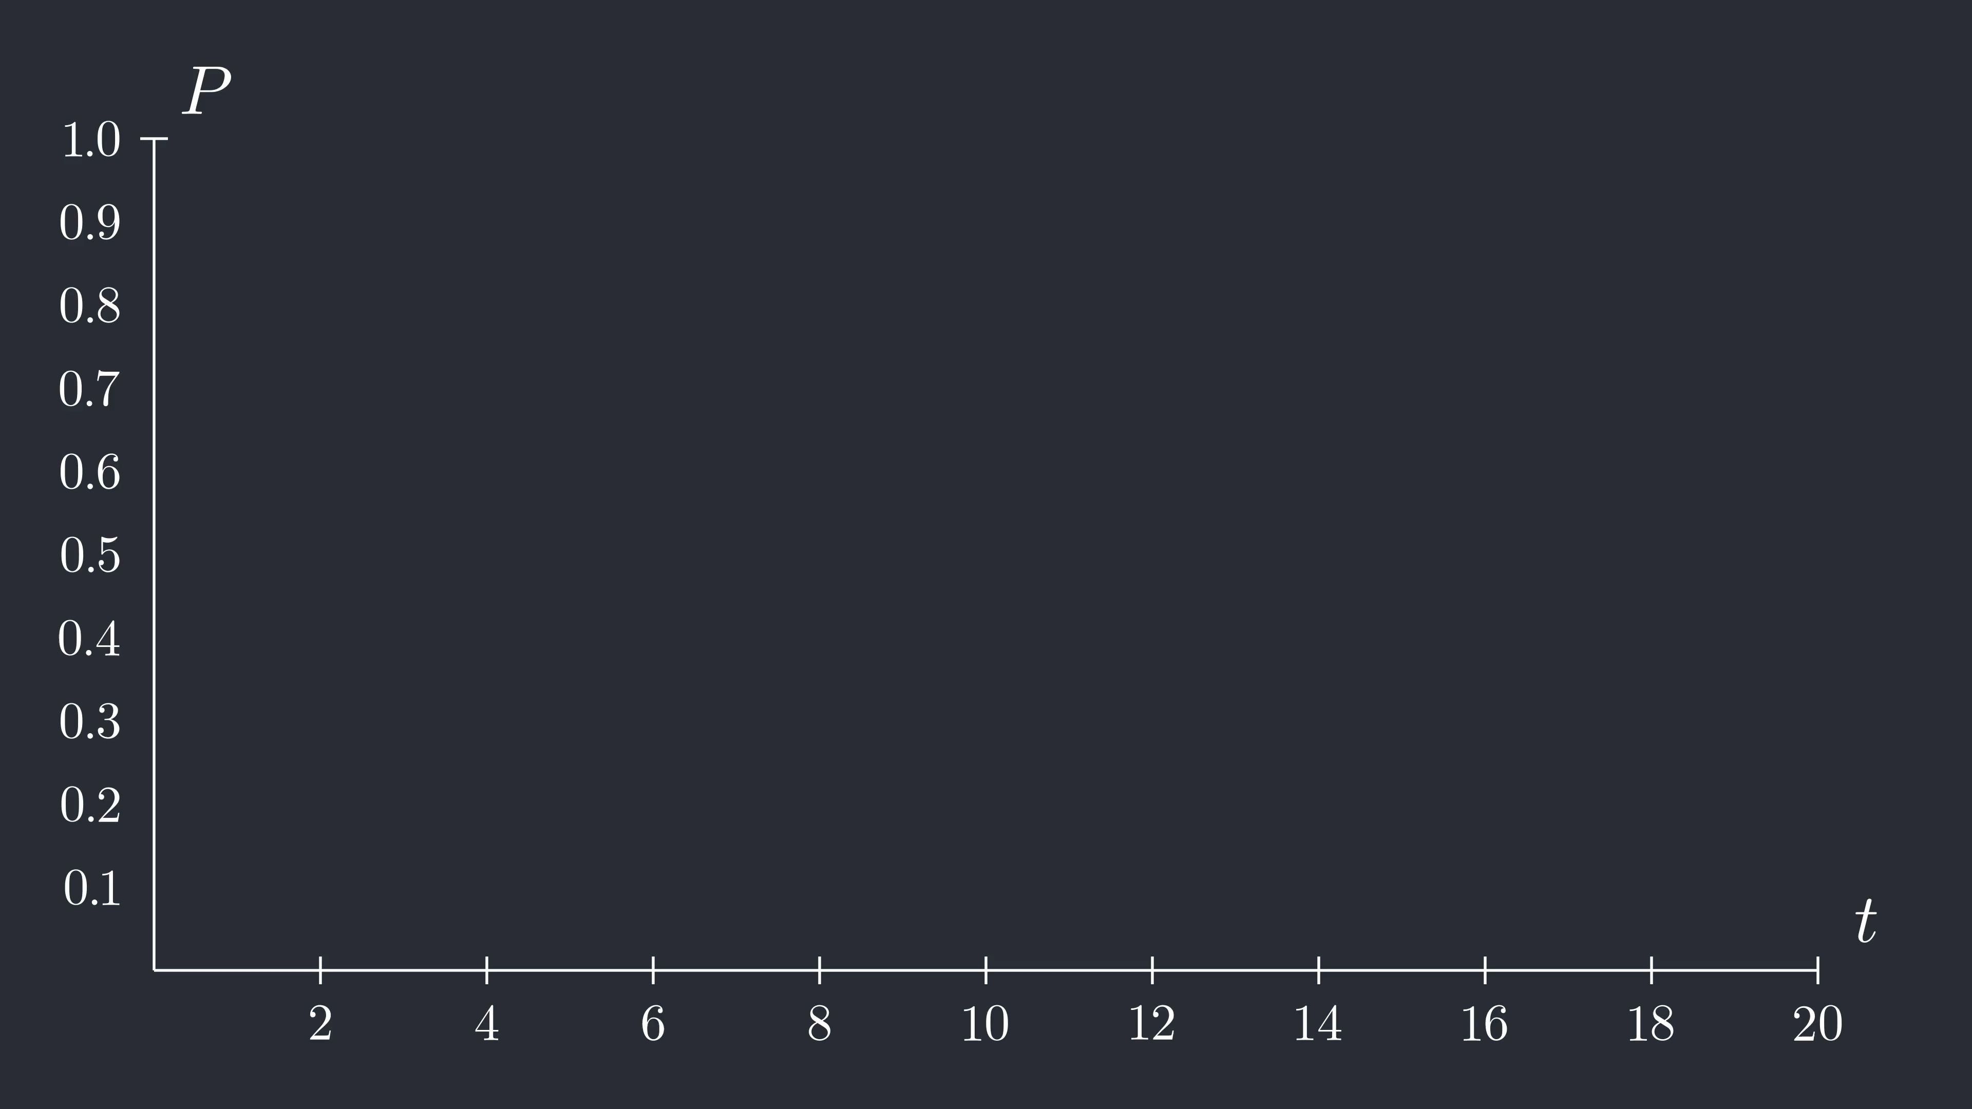
GRAPH
Notes:
Zeroth – Fast infection.
Consider condensing the days.

Slide 28
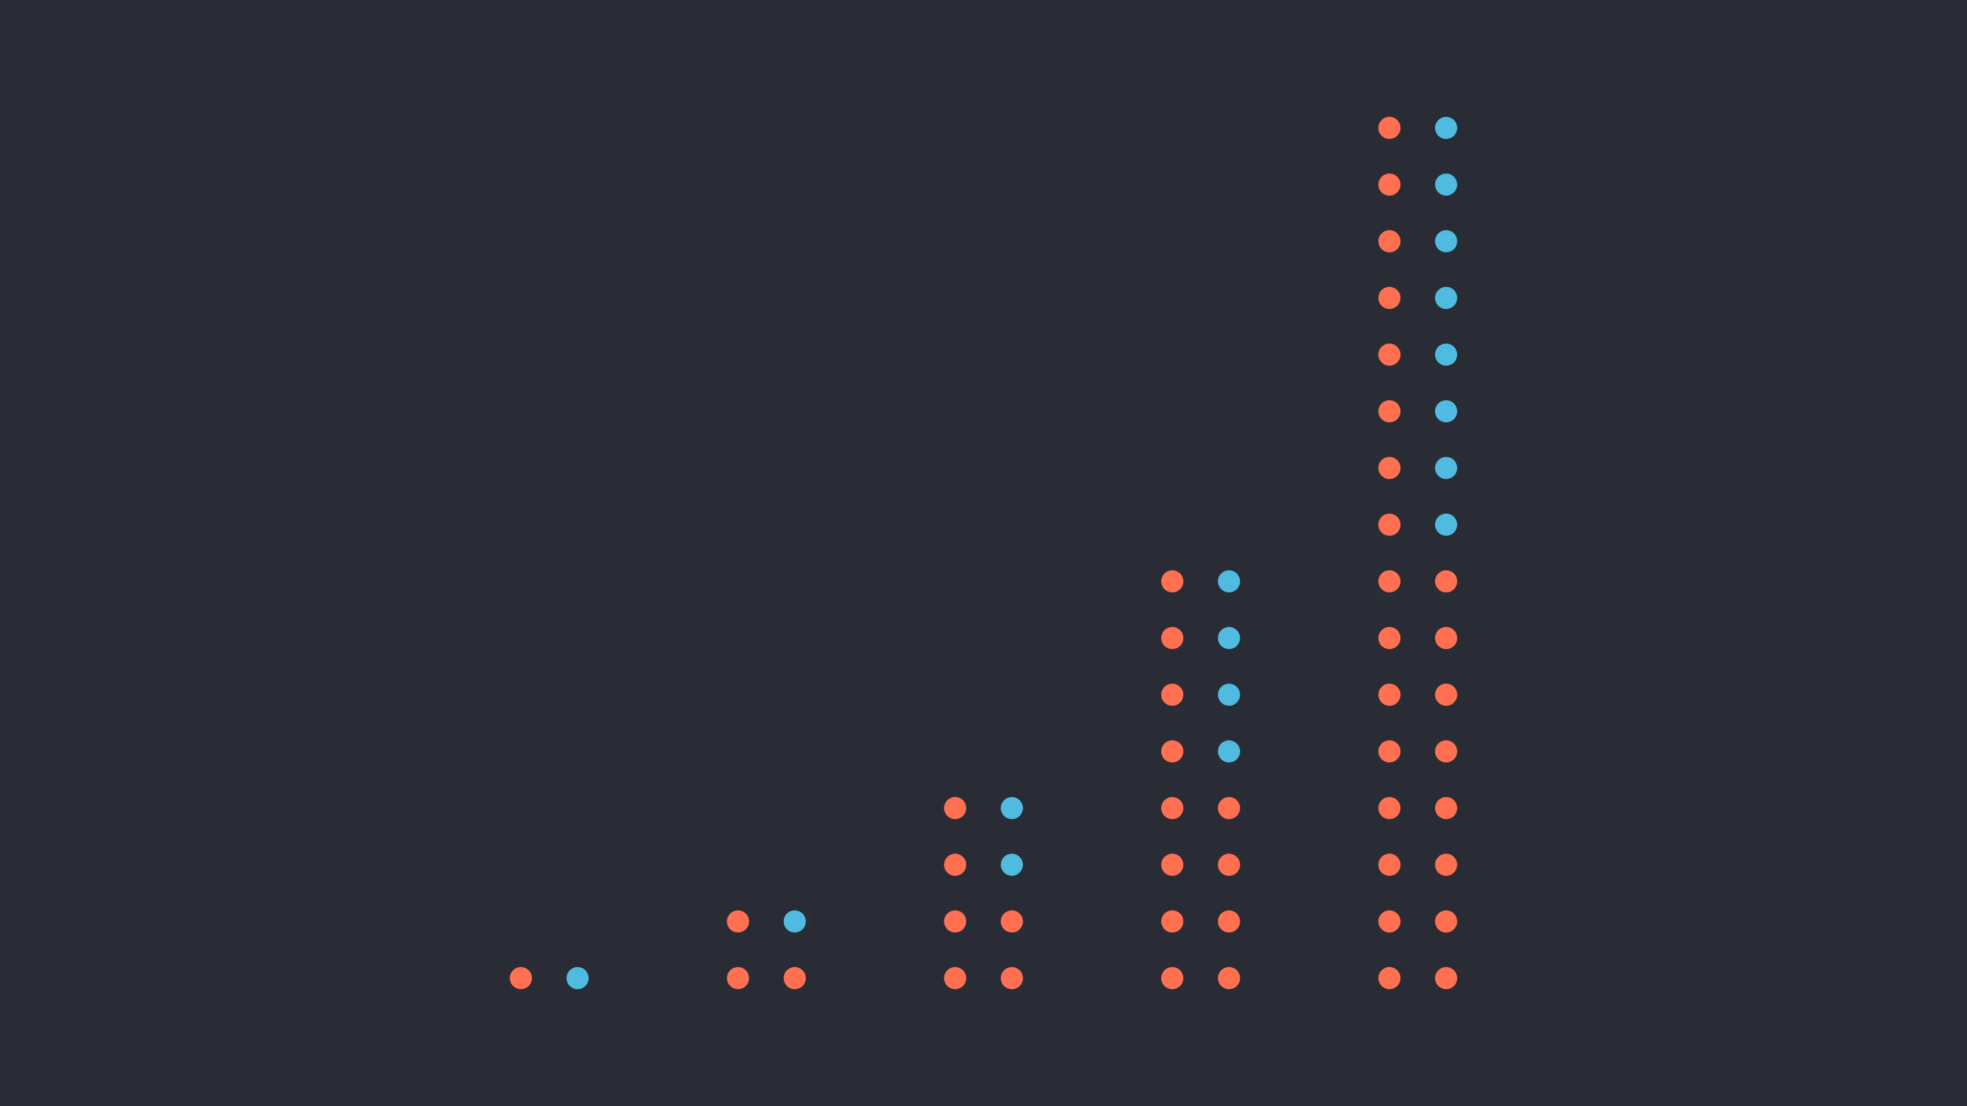
Model
Notes:
Dots – 1-1, 2-1, 4-2, etc.

Slide 29
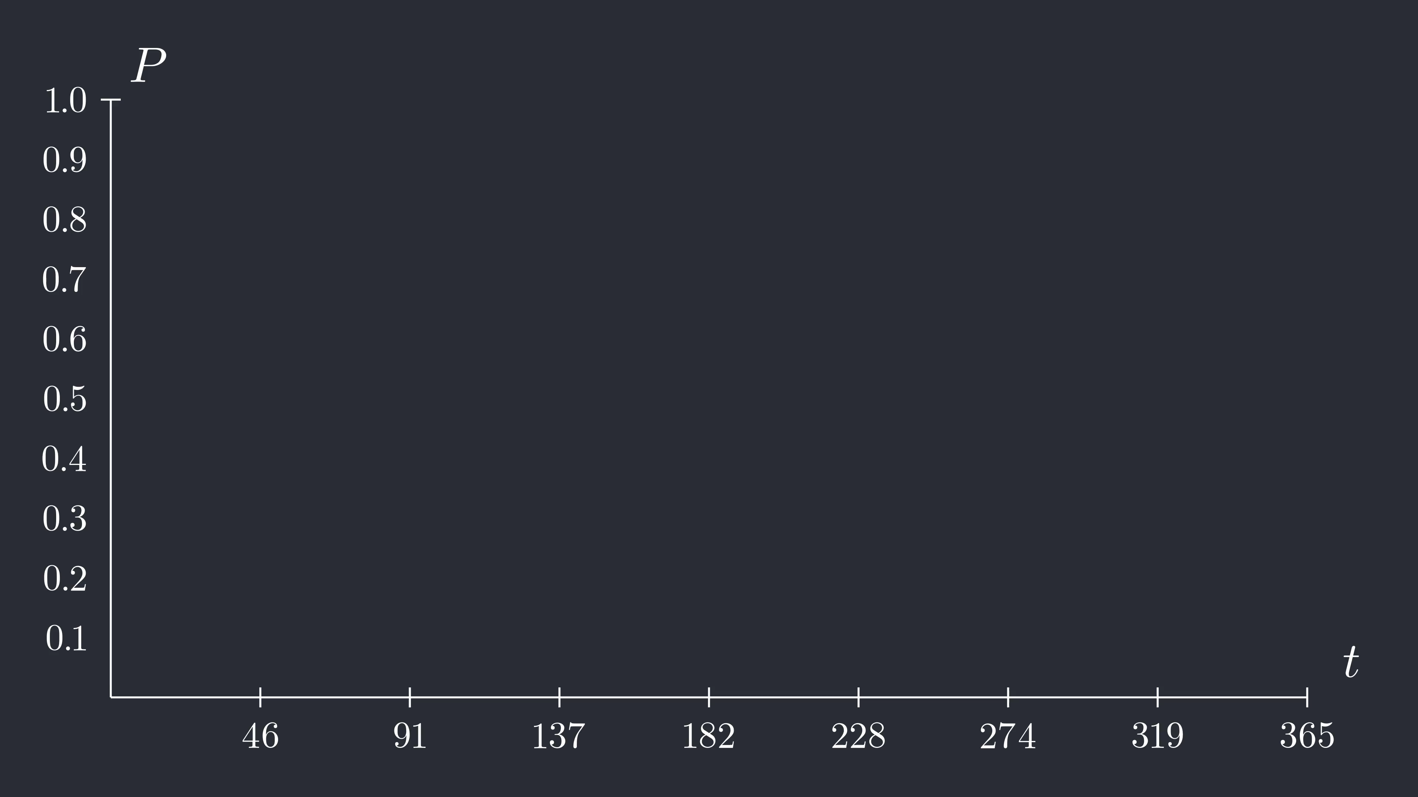
GRAPH
Notes:
first
Consider 50% infected contact

Slide 30
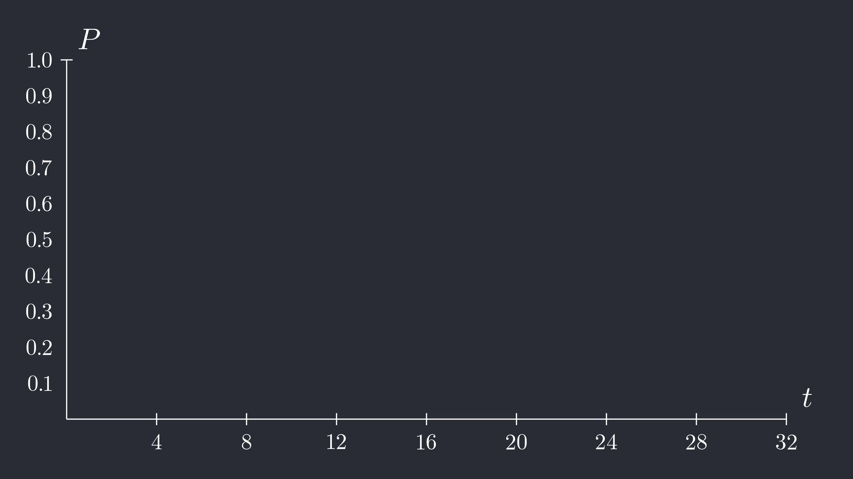
Graph
Notes:
Logistic Growth
Consider letting sick become recovered

Slide 31

Graph
Notes:
Decay
Found a cure – start the decline
How might the graph look when we combine them?

Slide 32
Graph
Notes:
Combined

Slide 33
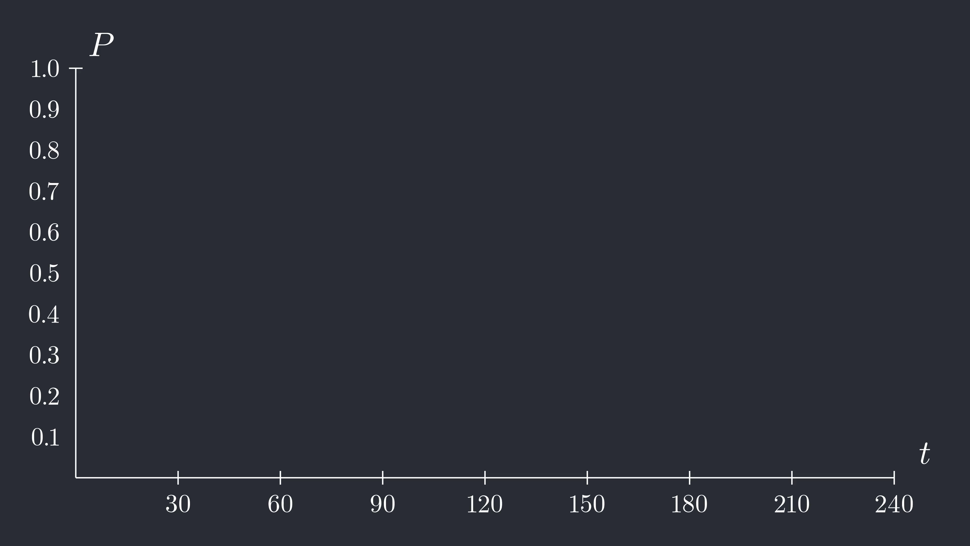
Graph
Notes:
Logistic Growth
Consider letting sick become recovered

Slide 34
Infection’s Reproduction Number
How can an infection spread throughout a population?
Epidemiologists use R to calculate an infection’s ability to spread.
The starting R value of an infection is considered R₀ (R-Naught)
Examples of R:
Common Cold: R₀ = 2 to 3
Measles: R₀ = 12 to 18
Covid-19: R₀ = ?

Slide 35
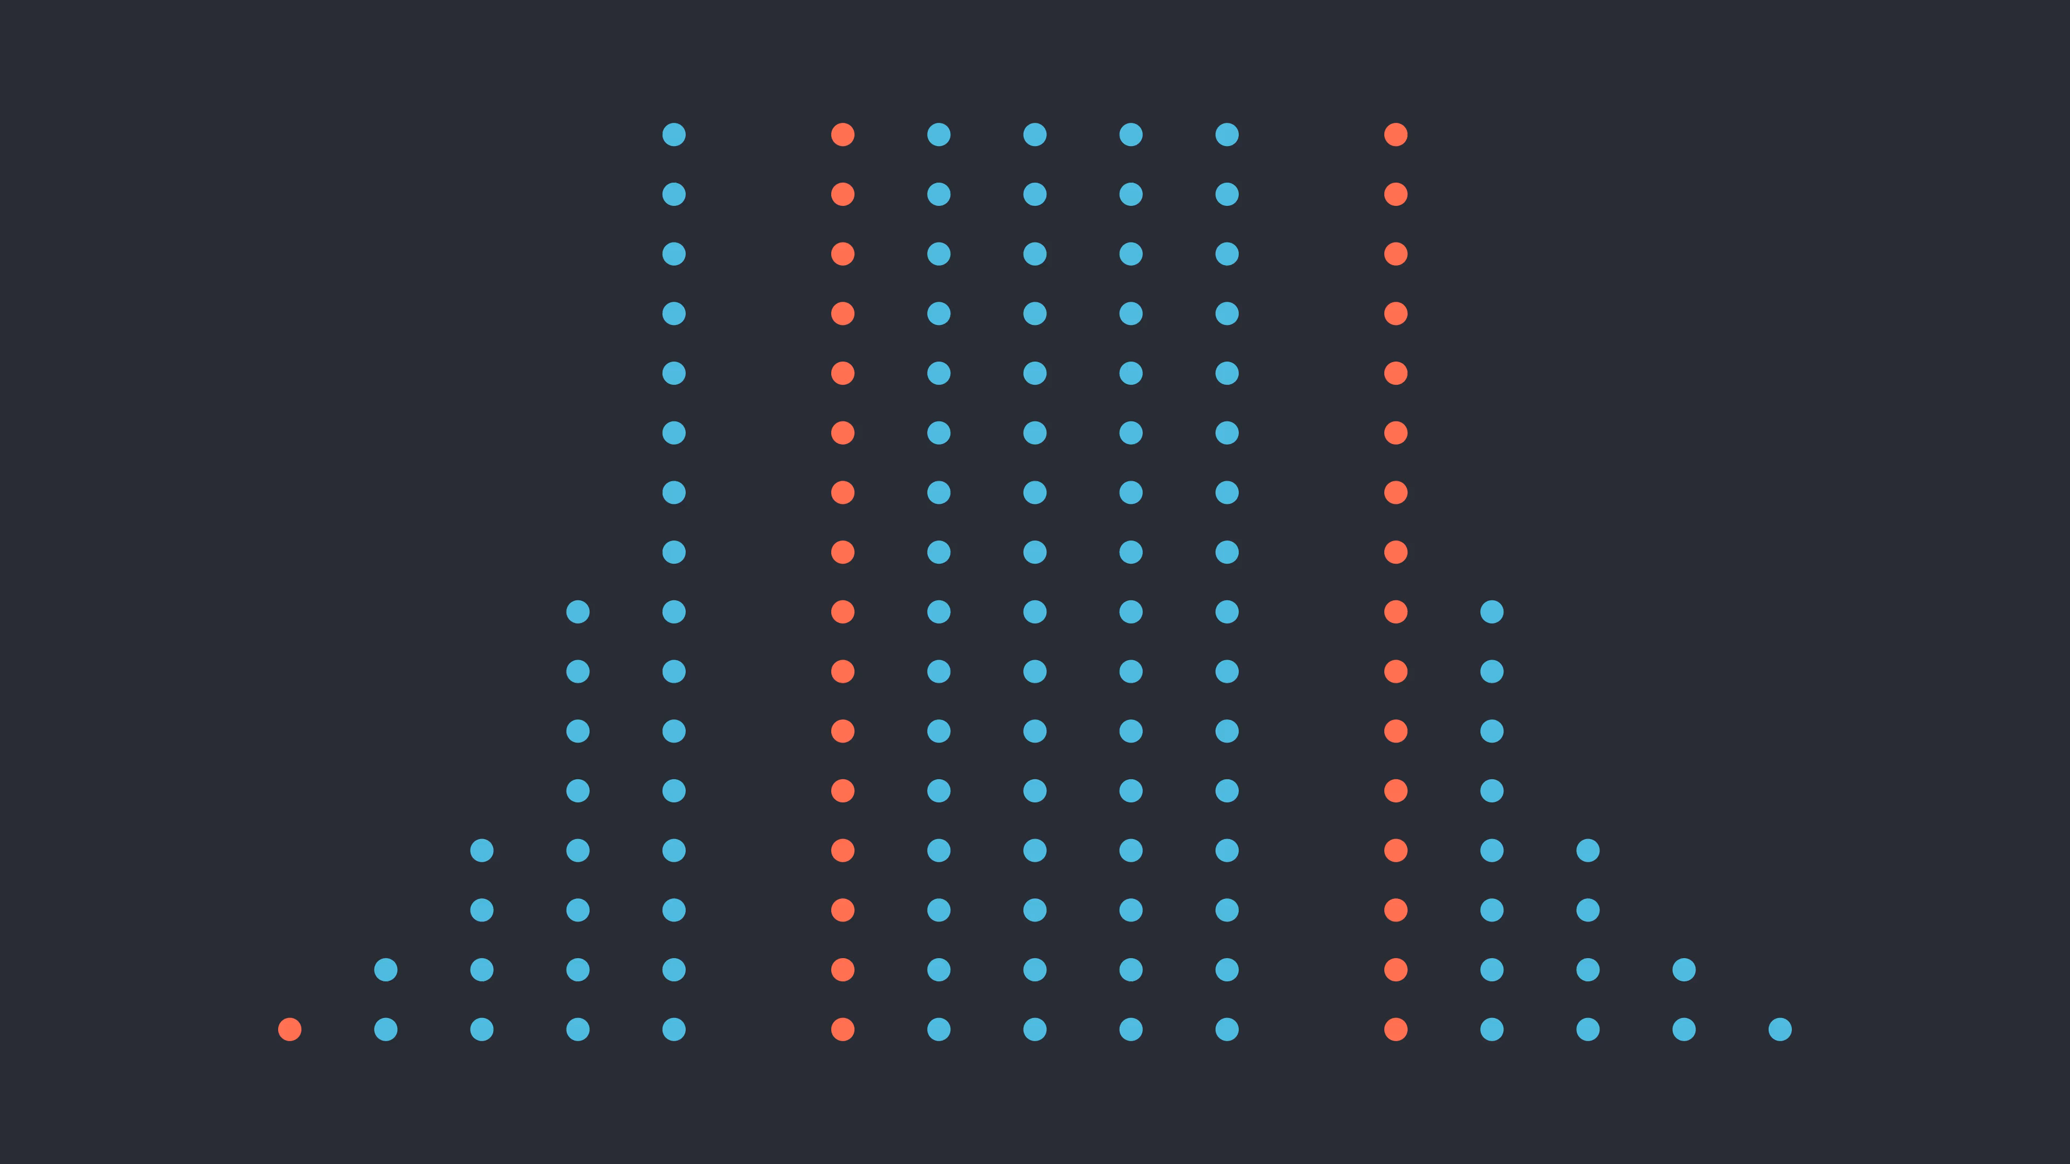
Infection’s Reproduction Number

Slide 36
Infection’s Reproduction Number
How can an infection spread throughout a population?
Epidemiologists use R to calculate an infection’s ability to spread.
The starting R value of an infection is considered R₀ (R-Naught)
Examples of R:
Common Cold: R₀ = 2 to 3
Measles: R₀ = 12 to 18
Covid-19: R₀ = ?

Slide 37
Half

Slide 38
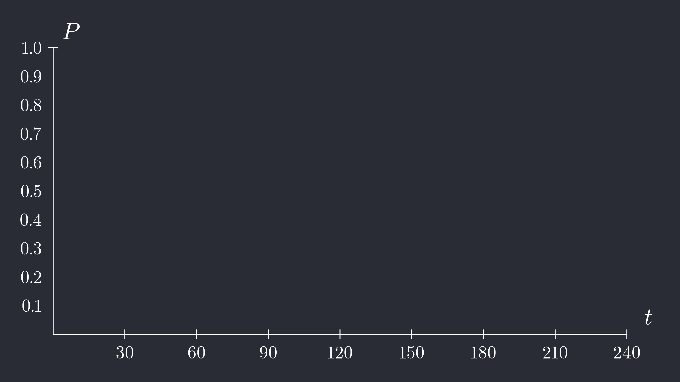
Double

Slide 39
Creating an Epidemic Model
Steven Blythe

